Slide 1
Chubby
Lecturer: Ngo Huy Bien
Software Engineering Department
Faculty of Information Technology
VNUHCM - University of Science
Ho Chi Minh City, Vietnam
nhbien@fit.hcmus.edu.vn

Slide 2

Objectives

Slide 3

Contents

Slide 4

References
Mike Burrows (2006). The Chubby Lock Service for Loosely-Coupled Distributed Systems.

Slide 5


Slide 6
Chubby [1]
This paper describes a lock service called Chubby.
The purpose of the lock service is to allow its clients to synchronize their activities and to agree on basic information about their environment.
The primary goals included reliability, availability to a moderately large set of clients, and easy-to-understand semantics;
throughput and storage capacity were considered secondary.

Slide 7
Why Chubby?
To deal with the problem of electing a leader from among a set of otherwise equivalent servers.
Use Chubby as a well-known and available location to store a small amount of meta-data.
Before Chubby was deployed, most distributed systems at Google used ad hoc methods for primary election (when work could be duplicated without harm), or required operator intervention (when correctness was essential).

Slide 8
Client Interface
Chubby’s client interface is similar to that of a simple file system that performs whole-file reads and writes, augmented with advisory locks and with notification of various events such as file modification.
Building Chubby was an engineering effort required to fill the needs mentioned above; it was not research.
We claim no new algorithms or techniques.

Slide 9
Design Rationale
A lock service has some advantages over a client library.
First, our developers sometimes do not plan for high availability in the way one would wish.
Second, many of our services that elect a primary or that partition data between their components need a mechanism for advertising the results.
Third, a lock-based interface is more familiar to our programmers.
Last, distributed-consensus algorithms use quorums to make decisions, so they use several replicas to achieve high availability. Thus, a lock service reduces the number of servers needed for a reliable client system to make progress.

Slide 10
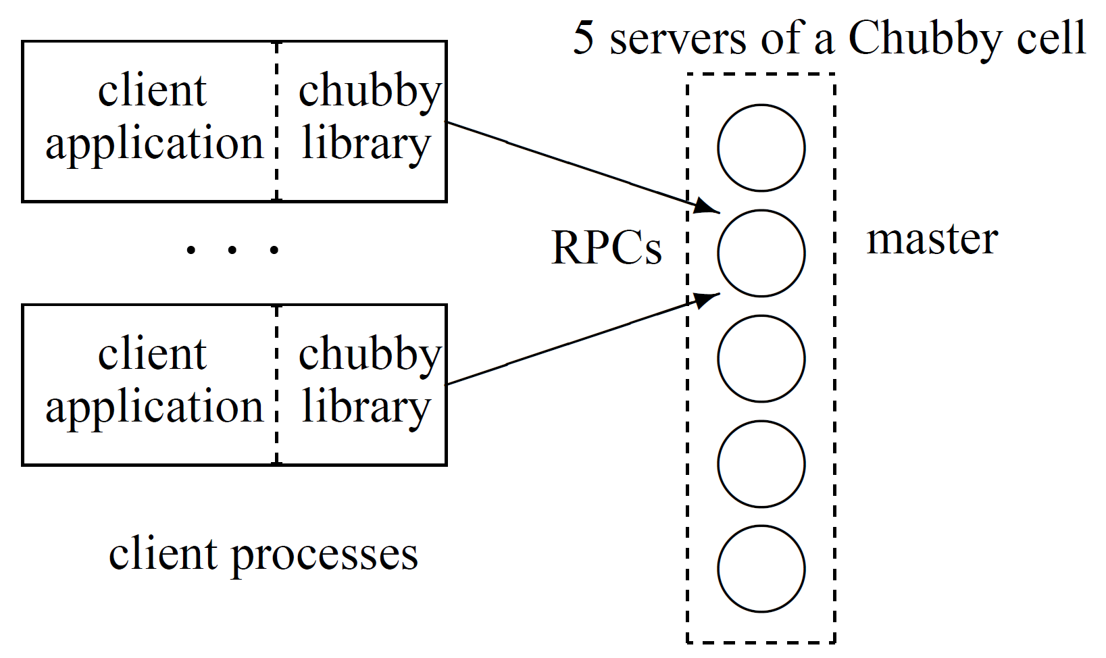
System Structure

Slide 11
Files and Directories (I)
Chubby exports a file system interface similar to, but simpler than that of UNIX.
It consists of a strict tree of files and directories in the usual way, with name components separated by slashes. A typical name is:
/ls/foo/wombat/pouch
Each directory contains a list of child files and directories, while each file contains a sequence of uninterpreted bytes.

Slide 12
Files and Directories (II)
/ls/foo/wombat/pouch
The ls prefix is common to all Chubby names, and stands for lock service.
The second component (foo) is the name of a Chubby cell; it is resolved to one or more Chubby servers via DNS lookup.
A special cell name local indicates that the client’s local Chubby cell should be used; this is usually one in the same building and thus the one most likely to be accessible.
The remainder of the name, /wombat/pouch, is interpreted within the named Chubby cell.

Slide 13
Nodes and Handles
The name space contains only files and directories, collectively called nodes.
Nodes may be either permanent or ephemeral.
Any node may be deleted explicitly, but ephemeral nodes are also deleted if no client has them open (and, for directories, they are empty).
Ephemeral files are used as temporary files, and as indicators to others that a client is alive.
Clients open nodes to obtain handles that are analogous to UNIX file descriptors.

Slide 15
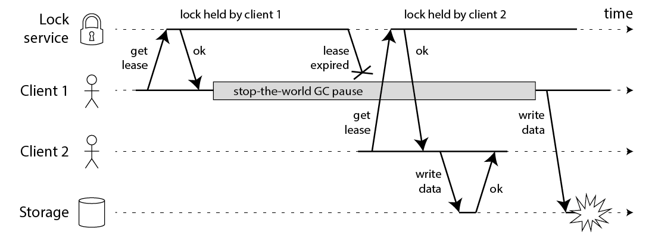
Pessimistic Lock
Implementing a pessimistic lock, we have a big issue; what happens if the lock owner doesn’t release it?
The lock will be held forever and we could be in a deadlock.
To prevent this issue, we will set an expiration time on the lock, so the lock will be auto-released.

Slide 16
Potential Inconsistency
https://martin.kleppmann.com/2016/02/08/how-to-do-distributed-locking.html

Slide 17
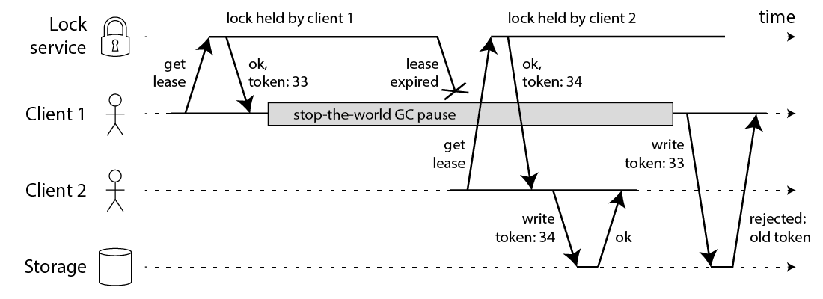
Fencing Token
You need to include a fencing token with every write request to the storage service.
In this context, a fencing token is simply a number that increases (e.g. incremented by the lock service) every time a client acquires the lock.
Note this requires the storage server to take an active role in checking tokens, and rejecting any writes on which the token has gone backwards.

Slide 18
Further Reading
https://martin.kleppmann.com/2016/02/08/how-to-do-distributed-locking.html
https://redis.io/docs/manual/patterns/distributed-locks/
https://stackoverflow.com/questions/74755667/how-are-keys-locked-in-kv-stores

Slide 20

Thank You & See You Again

